Slide 1
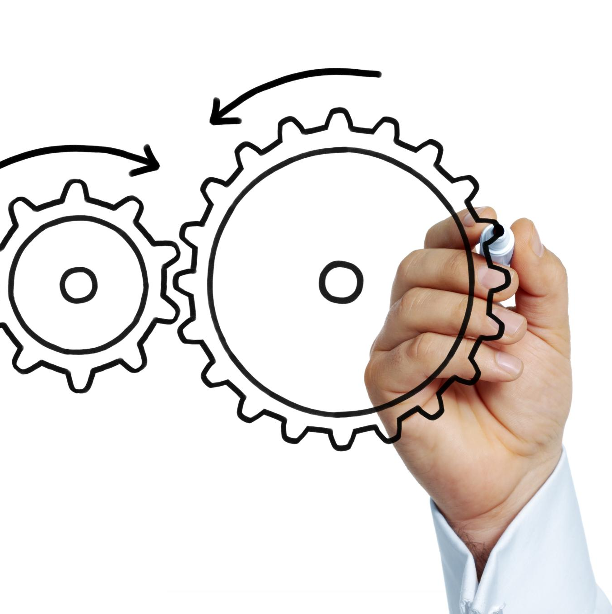
Navigating the Software Development Life Cycle
Understanding SDLC and its phases for business success
Notes:
AI-generated content may be incorrect. --- This presentation aims to provide non-technical business personnel with a clear understanding of the Software Development Life Cycle (SDLC). We will explore its significance in business, the roles involved, and the various phases from requirements gathering to deployment. Image source: Microsoft 365 content library

Slide 2
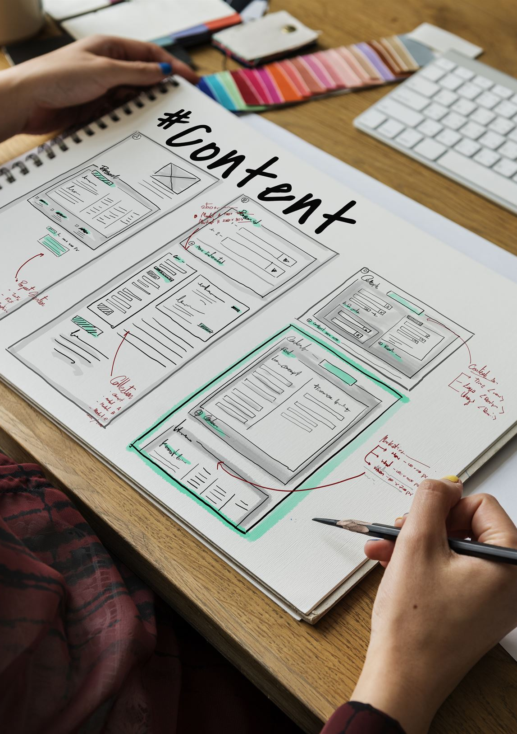
Agenda for SDLC Overview
Understanding the Software Development Life Cycle (SDLC)
Requirements Gathering and Analysis
Information Imparting and Impact Analysis
Design Phases: High-Level and Low-Level Design
Technical Breakdown and Development Preparation
Development and Testing
Deployment and Production Release
Notes:
--- We will cover a comprehensive overview of the SDLC, highlighting its importance, the roles involved, and the phases of the cycle. We will also delve into requirements gathering, design phases, development, testing, and deployment. Image source: Microsoft 365 content library

Slide 3
Understanding the Software Development Life Cycle (SDLC)
Notes:
The SDLC is a structured approach to software development that ensures quality and efficiency. It encompasses a series of phases that guide the process from initial concept to deployment and maintenance.

Slide 4
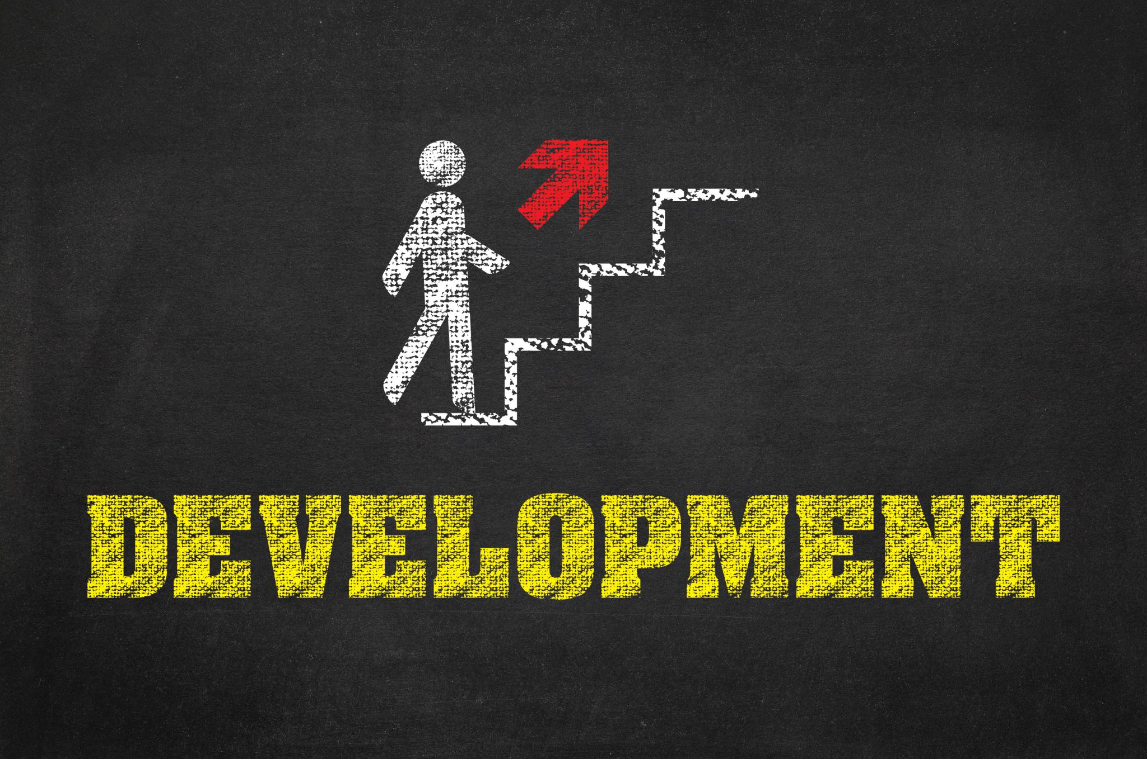
Overview of SDLC
Planning Phase
The planning phase involves defining the scope and objectives of the project to ensure alignment with business goals.
Requirements Gathering
In this phase, stakeholders' needs are collected and documented to guide the development process effectively.
Design Phase
The design phase involves creating the architecture and user interface specifications for the software solution.
Development and Testing
Development is followed by rigorous testing to identify and fix issues, ensuring quality before deployment.
Notes:
--- The SDLC consists of several key phases: planning, requirements gathering, design, development, testing, deployment, and maintenance. Each phase plays a vital role in ensuring the final product meets business objectives. Image source: Microsoft 365 content library

Slide 5
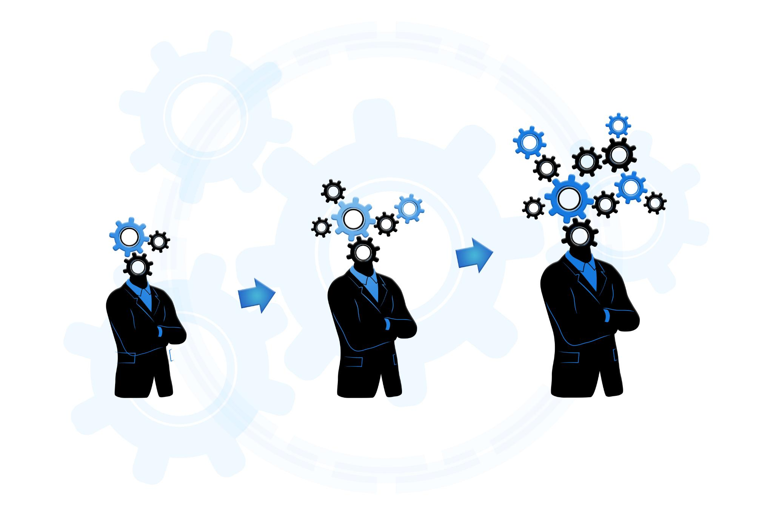
Importance of SDLC in Business
Minimizing Risks
The SDLC framework helps identify and mitigate potential risks early in the project, ensuring smoother execution.
Improving Project Management
With SDLC, businesses can enhance their project management capabilities, ensuring timely delivery and resource allocation.
Aligning with Organizational Goals
The SDLC ensures that the software development process aligns with the broader objectives of the organization, enhancing overall productivity.
Facilitating Team Communication
Implementing SDLC promotes better collaboration and communication among teams, leading to improved outcomes and efficiency.
Notes:
--- Implementing the SDLC helps businesses minimize risks, improve project management, and ensure that the software aligns with organizational goals. It also facilitates better communication among teams. Image source: Microsoft 365 content library

Slide 6

Roles Involved in SDLC
Project Managers
Project managers oversee the entire software development process, ensuring that projects are completed on time and within budget.
Business Analysts
Business analysts gather requirements and bridge the gap between stakeholders and the development team to ensure the project meets business needs.
Developers
Developers are responsible for coding and building the software, translating requirements into functional applications.
Quality Assurance Testers
Quality assurance testers ensure the software is free of defects and meets the specified requirements through rigorous testing.
Notes:
--- Various roles are essential in the SDLC, including project managers, business analysts, developers, and quality assurance testers. Each role contributes unique skills necessary for a successful software project. Image source: Microsoft 365 content library

Slide 7
Requirements Gathering and Analysis
Notes:
This phase focuses on collecting and analyzing the needs of stakeholders to define project goals clearly. Effective requirements gathering helps ensure the final product meets user expectations.

Slide 8

Process of Requirements Gathering
Methods of Gathering Requirements
Various methods such as interviews, surveys, and workshops are utilized to gather requirements effectively.
Stakeholder Engagement
Engaging with stakeholders during the requirements gathering process is essential to understand their expectations.
Comprehensive Information Collection
The goal is to collect comprehensive information to ensure the software meets stakeholder needs and expectations.
Notes:
--- Requirements gathering involves various methods, including interviews, surveys, and workshops. This process aims to collect comprehensive information about what stakeholders expect from the software. Image source: Microsoft 365 content library

Slide 9

Techniques for Effective Requirement Analysis
Use Cases
Use cases are valuable tools for capturing functional requirements by outlining interactions between users and systems.
User Stories
User stories provide a simple way to describe requirements from the user's perspective, focusing on their needs and goals.
Prototyping
Prototyping allows stakeholders to visualize requirements early, facilitating feedback and ensuring alignment with user expectations.
Notes:
--- Effective techniques for requirement analysis include using use cases, user stories, and prototyping. These methods help clarify requirements and ensure that all needs are addressed. Image source: Microsoft 365 content library

Slide 10

Collaborating with Stakeholders
Importance of Collaboration
Collaboration with stakeholders is vital to accurately gathering project requirements and achieving successful outcomes.
Regular Communication
Maintaining regular communication with stakeholders ensures alignment and clarity throughout the project lifecycle.
Validation of Requirements
Engaging stakeholders in the validation process is essential for ensuring that their needs are accurately understood.
Notes:
--- Collaboration with stakeholders is critical for gathering accurate requirements. Regular communication ensures that everyone is aligned and that requirements are understood and validated. Image source: Microsoft 365 content library

Slide 11
Information Imparting and Impact Analysis
Notes:
Once requirements are gathered, it's essential to communicate them effectively to the design team and analyze any potential impacts of proposed changes.

Slide 12
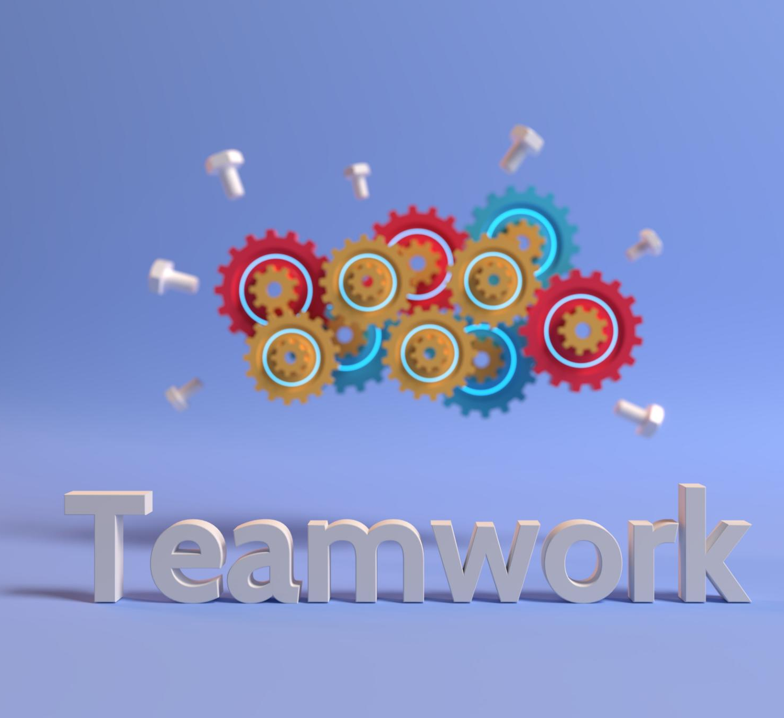
Communicating Requirements to Design Team
Importance of Clear Communication
Effective communication ensures that all requirements are understood and reduces the potential for errors in design.
Documentation Practices
Thorough documentation helps in outlining requirements and serves as a reference for the design team throughout the project.
Workshops and Collaboration
Workshops facilitate active participation and allow team members to discuss and clarify requirements effectively.
Regular Updates
Providing regular updates keeps the design team informed of any changes, ensuring alignment throughout the project.
Notes:
--- Clear communication of requirements to the design team is crucial. This can be achieved through documentation, workshops, and regular updates to ensure everyone is on the same page. Image source: Microsoft 365 content library

Slide 13

Conducting Impact Analysis
Assessing Changes
Impact analysis requires evaluating how changes in requirements can influence the project's scope and deliverables.
Identifying Risks
This analysis helps identify potential risks associated with changes, allowing teams to proactively manage them.
Informed Decision-Making
The outcomes of impact analysis inform decision-making processes, ensuring that project adjustments are made strategically.
Notes:
--- Impact analysis involves assessing how changes in requirements may affect the overall project. This helps in identifying potential risks and informs decision-making. Image source: Microsoft 365 content library

Slide 14
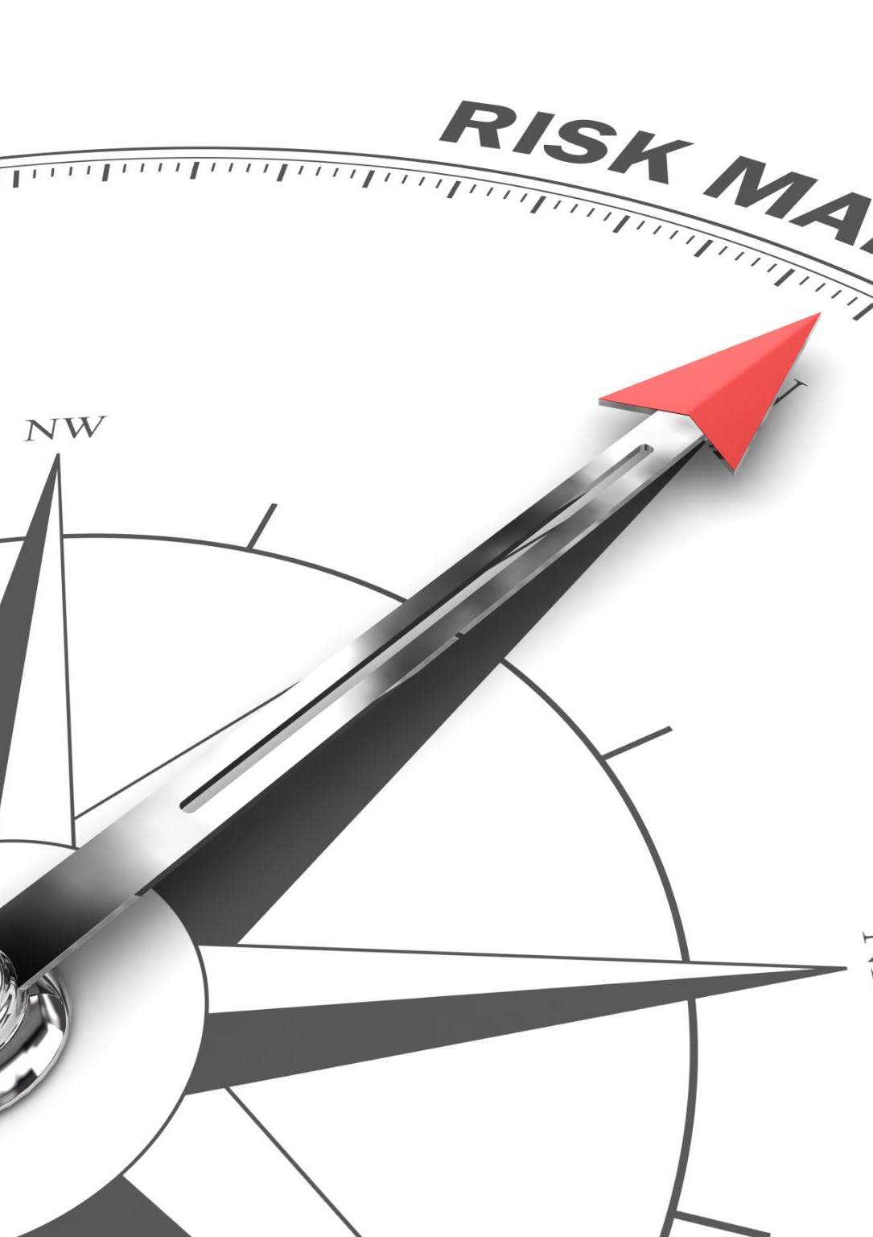
Managing Changes and Risks
Importance of Change Management
Effective change management is critical for adapting to new requirements within the Software Development Life Cycle (SDLC).
Risk Minimization Strategies
Implementing strategies to minimize risks ensures that project disruptions are kept to a minimum during development.
Adapting to New Requirements
Establishing a robust process allows teams to swiftly adapt to changing project requirements without compromising quality.
Notes:
--- Managing changes and risks is essential throughout the SDLC. Establishing a change management process helps adapt to new requirements while minimizing disruptions to the project. Image source: Microsoft 365 content library

Slide 15
Design Phases: High-Level and Low-Level Design
Notes:
The design phase translates requirements into a blueprint for development. It includes both high-level and low-level design aspects to ensure a well-structured product.

Slide 16

High-Level Design: Creating Architecture
Overview of System Architecture
High-level design emphasizes the overall architecture of the system, illustrating the foundational components and their interactions.
Defining Components
This phase involves defining each component's role and how they contribute to the system's functionality and overall goals.
Interaction Between Components
Understanding how components interact is crucial for ensuring the system meets its requirements effectively and efficiently.
Notes:
--- High-level design focuses on the overall architecture of the system, defining components and how they interact. This phase ensures that the framework supports the requirements effectively. Image source: Microsoft 365 content library

Slide 17

Low-Level Design: Detailed Specifications
Component Specifications
Low-level design requires detailed specifications for each software component to ensure clarity and consistency during development.
Algorithms and Data Structures
Defining algorithms and data structures is crucial in low-level design, as they dictate the functionality and efficiency of the software.
Interfaces for Developers
Creating clear interfaces helps guide developers in the implementation process, ensuring seamless integration between components.
Notes:
--- Low-level design involves creating detailed specifications for each component, outlining algorithms, data structures, and interfaces to guide developers during implementation. Image source: Microsoft 365 content library

Slide 18

Ensuring Design Alignment with Requirements
Importance of Design Alignment
Ensuring design alignment with requirements is critical to delivering a successful project that meets stakeholders' expectations.
Regular Reviews
Conducting regular reviews throughout the design process ensures ongoing alignment with project goals and requirements.
Feedback Loops
Incorporating feedback loops allows for continuous improvement of the design, adapting to changing requirements and insights.
Notes:
--- It is crucial to ensure that the design aligns with the gathered requirements. Regular reviews and feedback loops help verify that the design meets business needs. Image source: Microsoft 365 content library

Slide 19
Technical Breakdown and Development Preparation
Notes:
Preparing for development involves breaking down the design into manageable tasks and ensuring that the development team has a clear understanding of requirements.

Slide 20

Technical Refinement for Development Team
Clarifying Project Aspects
Technical refinement is essential for clarifying the project's technical requirements and expectations before development begins.
Developer Resources
Ensuring that developers have the necessary resources, tools, and knowledge is critical to the success of the project.
Understanding the Requirements
A comprehensive understanding of the technical requirements helps developers to execute tasks efficiently and effectively.
Notes:
--- Technical refinement involves clarifying technical aspects of the project and ensuring that developers have the necessary resources and understanding to begin work. Image source: Microsoft 365 content library

Slide 21

Breaking Down Requirements Into Tasks
Enhanced Project Management
Breaking down requirements improves project management by allowing teams to focus on individual tasks effectively.
Progress Tracking
Dividing requirements into tasks enables better tracking of progress and milestones throughout the development process.
Timely Delivery
A clear task breakdown helps ensure that deliverables are completed on time and meet project deadlines.
Notes:
--- Breaking down requirements into specific tasks allows for better management of the development process. This enables the team to track progress and ensure timely delivery. Image source: Microsoft 365 content library

Slide 22

Estimating Development Time and Resources
Importance of Accurate Estimation
Accurate estimation of development time ensures that projects are completed on schedule and within budget.
Methods for Estimation
Various methods such as expert judgment, historical data, and estimation software can aid in resource allocation and timeline planning.
Resource Allocation Strategies
Effective resource allocation strategies help ensure that all aspects of the project are adequately supported and managed.
Notes:
--- Accurate estimation of development time and resources is critical for project planning. Various methods can be used to estimate timelines and resource allocation effectively. Image source: Microsoft 365 content library

Slide 23
Development and Testing
Notes:
During the development phase, code is written and tested to ensure it meets the specified requirements and quality standards. Testing is crucial for identifying and addressing issues.

Slide 24

Development of Code
Implementation of Design Specifications
In this phase, developers translate design specifications into functional code to create software that meets requirements.
Ensuring Functionality
Developers test and ensure that the software functions as intended, addressing any issues that may arise during coding.
Meeting Stakeholder Needs
The coding process is aligned with stakeholder needs, ensuring that the final product meets expectations and requirements.
Notes:
--- The actual coding process begins in this phase. Developers implement the design specifications, ensuring that the software functions as intended and meets stakeholder needs. Image source: Microsoft 365 content library

Slide 25
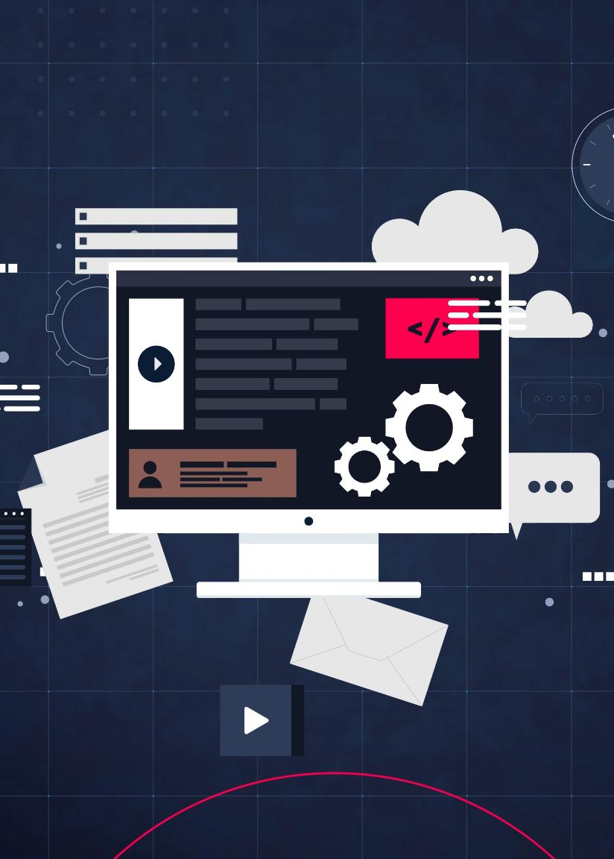
Unit Testing and Validation
Component Functionality Testing
Unit testing focuses on testing individual components to ensure they work as intended, reducing future issues.
Early Bug Detection
By validating components early, unit testing helps identify and fix bugs before they propagate into larger systems.
Integration Readiness
Unit tests ensure that components are ready for integration, leading to smoother system assembly and functionality.
Notes:
--- Unit testing involves testing individual components to ensure they function correctly. This validation helps catch bugs early before integrating components into the larger system. Image source: Microsoft 365 content library

Slide 26
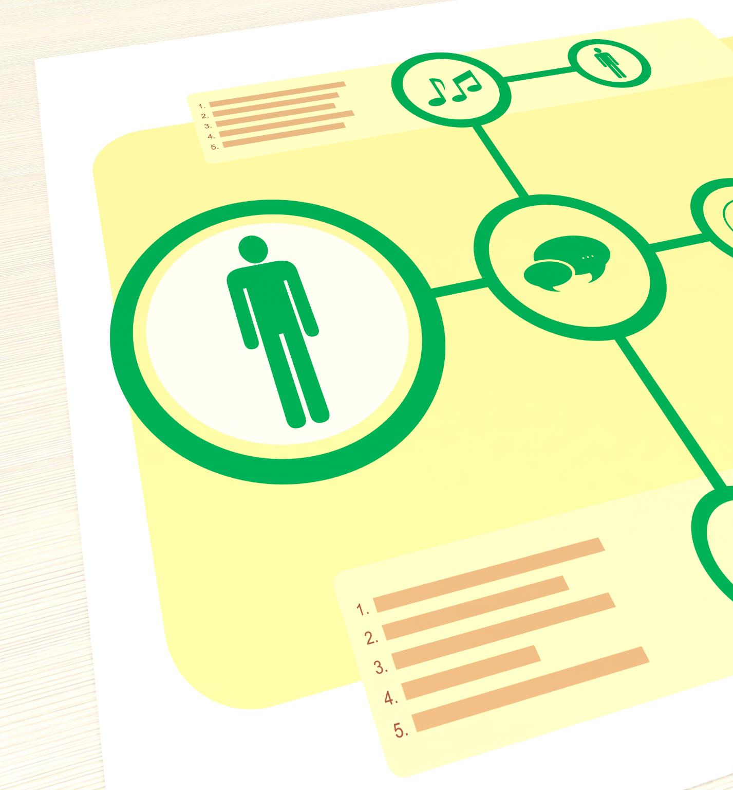
Functional and Regression Testing
Functional Testing Overview
Functional testing checks if the software behaves according to specified requirements and functions as intended.
Importance of Regression Testing
Regression testing is crucial to ensure that recent code changes do not negatively impact existing functionalities, preserving software stability.
Notes:
--- Functional testing verifies that the software meets specified requirements, while regression testing ensures that new changes do not adversely affect existing functionalities. Image source: Microsoft 365 content library

Slide 27
Deployment and Production Release
Notes:
The final phase involves deploying the software to production environments. This includes necessary preparations for a smooth release and ensuring ongoing support.

Slide 28

Deployments on Various Environments
Importance of Deployment
Proper deployment ensures that software functions correctly across different environments, leading to successful implementation.
Development Environment
The development environment is where initial coding and testing occur, allowing developers to build and refine the software.
Staging Environment
Staging is a replica of the production environment where final tests are conducted to ensure everything works as intended.
Production Environment
The production environment is where the software is live and used by end-users, making its proper deployment critical.
Notes:
--- Deploying the software across different environments (development, staging, and production) ensures that it functions correctly in each setting. Proper deployment is critical for success. Image source: Microsoft 365 content library

Slide 29

Production Release Process
Final Checks and Balances
The production release process involves rigorous final checks to ensure software quality and readiness for users.
Stakeholder Communication
Effective communication of release details to all stakeholders is crucial for a successful production release.
Notes:
--- The production release process includes the final checks and balances to ensure the software is ready for end-users. This phase also involves communicating release details to all stakeholders. Image source: Microsoft 365 content library

Slide 30

Post-Release Support and Maintenance
Importance of Ongoing Support
Ongoing support is essential for resolving issues that occur after software deployment and ensures user satisfaction.
Maintaining Software Relevance
Regular maintenance updates keep the software functional and relevant to user needs and industry standards.
Addressing Post-Deployment Issues
Post-deployment support helps in quickly addressing any unexpected issues that may arise, ensuring minimal disruption.
Notes:
--- Post-release support and maintenance are vital for addressing any issues that arise after deployment. This ongoing support ensures that the software remains functional and relevant. Image source: Microsoft 365 content library

Slide 31
Conclusion
Importance of Understanding SDLC
Understanding the Software Development Life Cycle helps bridge the gap between technical and non-technical teams, improving communication.
Facilitating Collaboration
Knowledge of SDLC enables non-technical personnel to collaborate effectively with development teams, enhancing teamwork.
Ensuring Project Success
A solid understanding of the development process leads to better decision-making and ultimately ensures successful project outcomes.
Notes:
Navigating the Software Development Life Cycle is crucial for non-technical business personnel to understand the development process. This knowledge facilitates better collaboration and ensures successful project outcomes.

